Slide 1
JS Browser BOM
Session 13
(slot 24-25)

Slide 2
Objectives
Introduction to BOM.
Browser objects.
  Window object
  //Document object
  History object
  Navigator object
  Location object

Slide 3
BOM (Browser Object Model)
The Browser Object Model (BOM) allows JavaScript to "talk to" the browser.
There are no official standards for the Browser Object Model (BOM).
Since modern browsers have implemented (almost) the same methods and properties for JavaScript interactivity, it is often referred to, as methods and properties of the BOM.

Slide 4
window object
DOM provides various objects to access and manipulate HTML elements in a standard way. The window object is the top level object in the JavaScript hierarchy. The window object represents a browser window.
window properties:
  defaultStatus: specifies or retrieves the default text to be displayed in the status bar of the browser window.
  closed: determines whether window is closed.
  document: represents an HTML document that contains different elements.
  history: contains history of the visited Uniform Resource Locators.
  location: contains the content of the specified URL.
  name: specifies or retrieves the name of the window.
  parent: retrieves the parent window that contains the child windows and elements.

Slide 5
window methods
alert(): displays an alert box that states the message and an OK button.
close(): closes the current window.
confirm(): prompts a dialog box that display a message with the OK and Cancel button.
creatPopup(): creates a pop-pup window.
focus(): focuses the current windows.
open(): opens specified file in a new browser window.
prompt(): prompts a dialog box that accepts input from the user.
print(): prints the content contained within the current element.
setInterval(): repeatedly invokes a function or evaluates an expression after the specified time intervals (in milliseconds).
setTimeout(): invokes a function after the specified time only once.

Slide 6
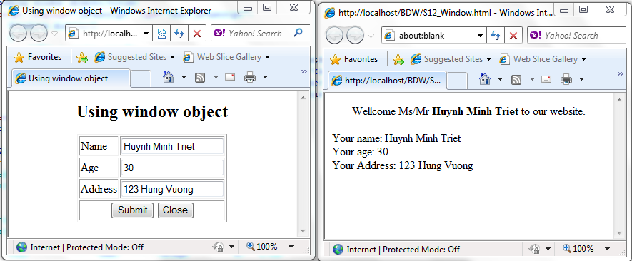
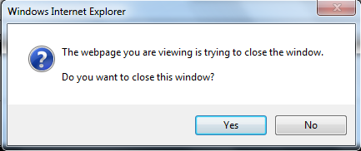
window object - Demo

Slide 7
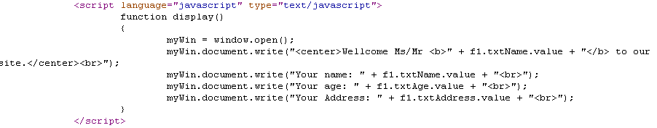
window object - Demo

Slide 8
document object
The document object is one of the basic JavaScript object. It represents the entire HTML document. It provides access to another elements such links, and so on. Each HTML page has only one document object. This object is created when you use the BODY element.
Collections: the document object uses a collection of arrays that contain information about the document content.
  anchors[]: contains information about the anchors contained in a document.
  forms[]: contains information about the form contained in a document.
  images[]: contains information about the images contained in a document.
  links[]: contains information about the links contained in a document.

Slide 9
document object
Properties of document object:
  body: provides accesses to the BODY element.
  cookie: specifies or retrieves all the cookies associated with the current document.
  domain: retrieves the domain name of the current document.
  title: specifies or retrieves the title of the document.

Slide 10
document object
Methods of document object:
  close(): closes data stream and displays the data collected using the open() method.
  getElementById(): retrieves collection of HTML elements by using the specified ID.
  getElementsByName(): retrieves collection of HTML elements by using the specified name.
  getElementsByTagName(): retrieves collection of HTML elements with the specified tag name.
  open(): opens a stream to accept the output from write()or writeln() methods.
  write(): writes the text to HTML expression to a document.

Slide 11
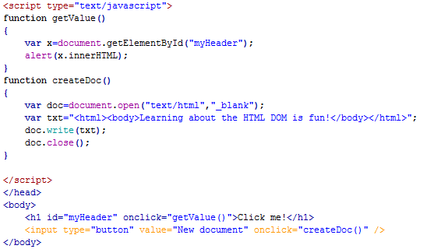
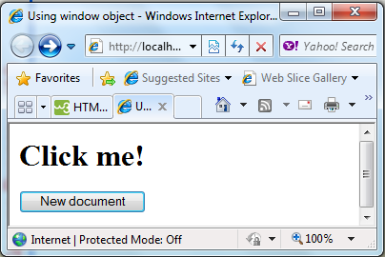
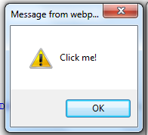
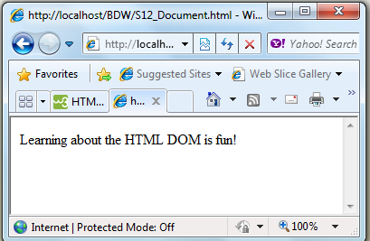
document object - Demo
Demo: S12_Document.html

Slide 12
history object
The history object is a part of the window object. It contains a set of URLs visited by a user in a browser window.
The history object is an array that allows you to a particular URL by specifying its index number in the array. The length property allows you to determine the number of URLs in the history list.
Methods of the history object:
  back(): Loads the previous URL in the history list.
  forward(): Loads the next URL in the history list
  go(): Loads a specific URL from the history list

Slide 13
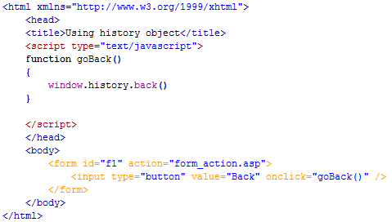
history object - Demo

Slide 14
navigator object
The navigator object contains information about the browser used by the client. It allows you to retrieve information such as name, version number, and code name of browser.
Properties of the navigator object:
  appCodeName: Returns the code name of the browser.
  appName: Returns the name of the browser .
  appVersion: Returns the version information of the browser.
  cookieEnable: Determines whether cookies are enabled in the browser .
  platform: Returns for which platform the browser is compiled
  userAgent: Returns the user-agent header sent by the browser to the server.

Slide 15
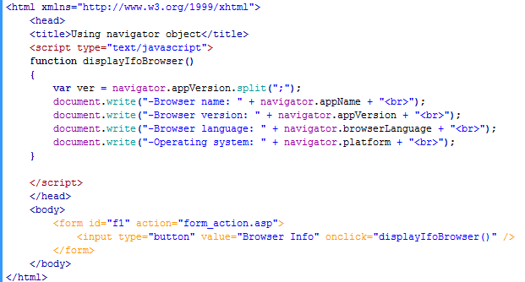
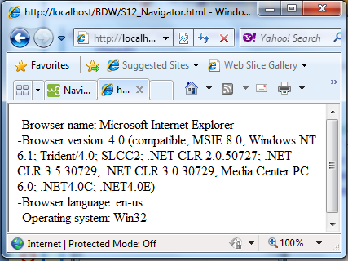
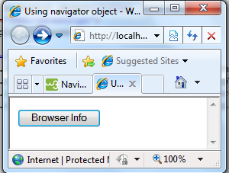
navigator object - Demo

Slide 16
location object
The location object allows you to access complete information of URL loaded in browser window. It is a part of the window object. A single URL is composed of different positions such as the host name, port number, and so on.
Properties of the navigator object:
  hash: Returns the anchor portion of a URL.
  host: Returns the hostname and port of a URL.
  hostname: Returns the hostname of a URL.
  href: Returns the entire URL.
  pathname: Returns the path name of a URL .
  port: Returns the port number the server uses for a URL.
  protocol: Returns the protocol of a URL.
  search: Returns the query portion of a URL.

Slide 17
location object
Methods of the navigator object:
  assign(): Loads a new document.
  reload(): Reloads the current document.
  replace(): Replaces the current document with a new one.

Slide 18
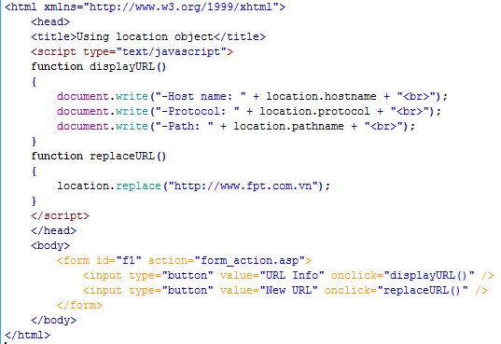
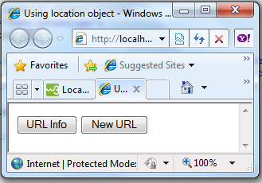
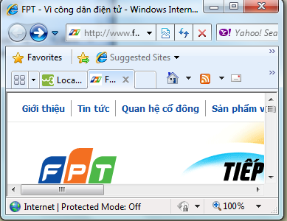
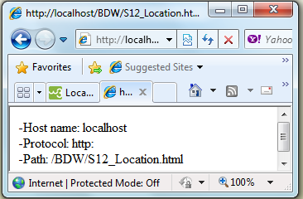
location object - Demo

Slide 19
Summary
BOM provides various built-in objects: Window object, document object, history object, navigator object, location object.
The window object is the top level object in the JavaScript hierarchy. Window object represents the browser window.
Document object is one of the basic JavaScript object. It represents the entire HTML document.

Slide 20
Summary…
History object is a set of URLs visited by users in a browser window
Navigator object contain information about the browser used by the client.
Location object allows to access complete information of the URL loaded in the browser window.

